Slide 1



CLIC 804:
Innovation by
Design
Session 08:
Pyramid Levels 3 & 4: The Execution Levels
Dr. Tim Faley
University of the Virgin Islands
Tfaley@UVI.edu

Slide 2
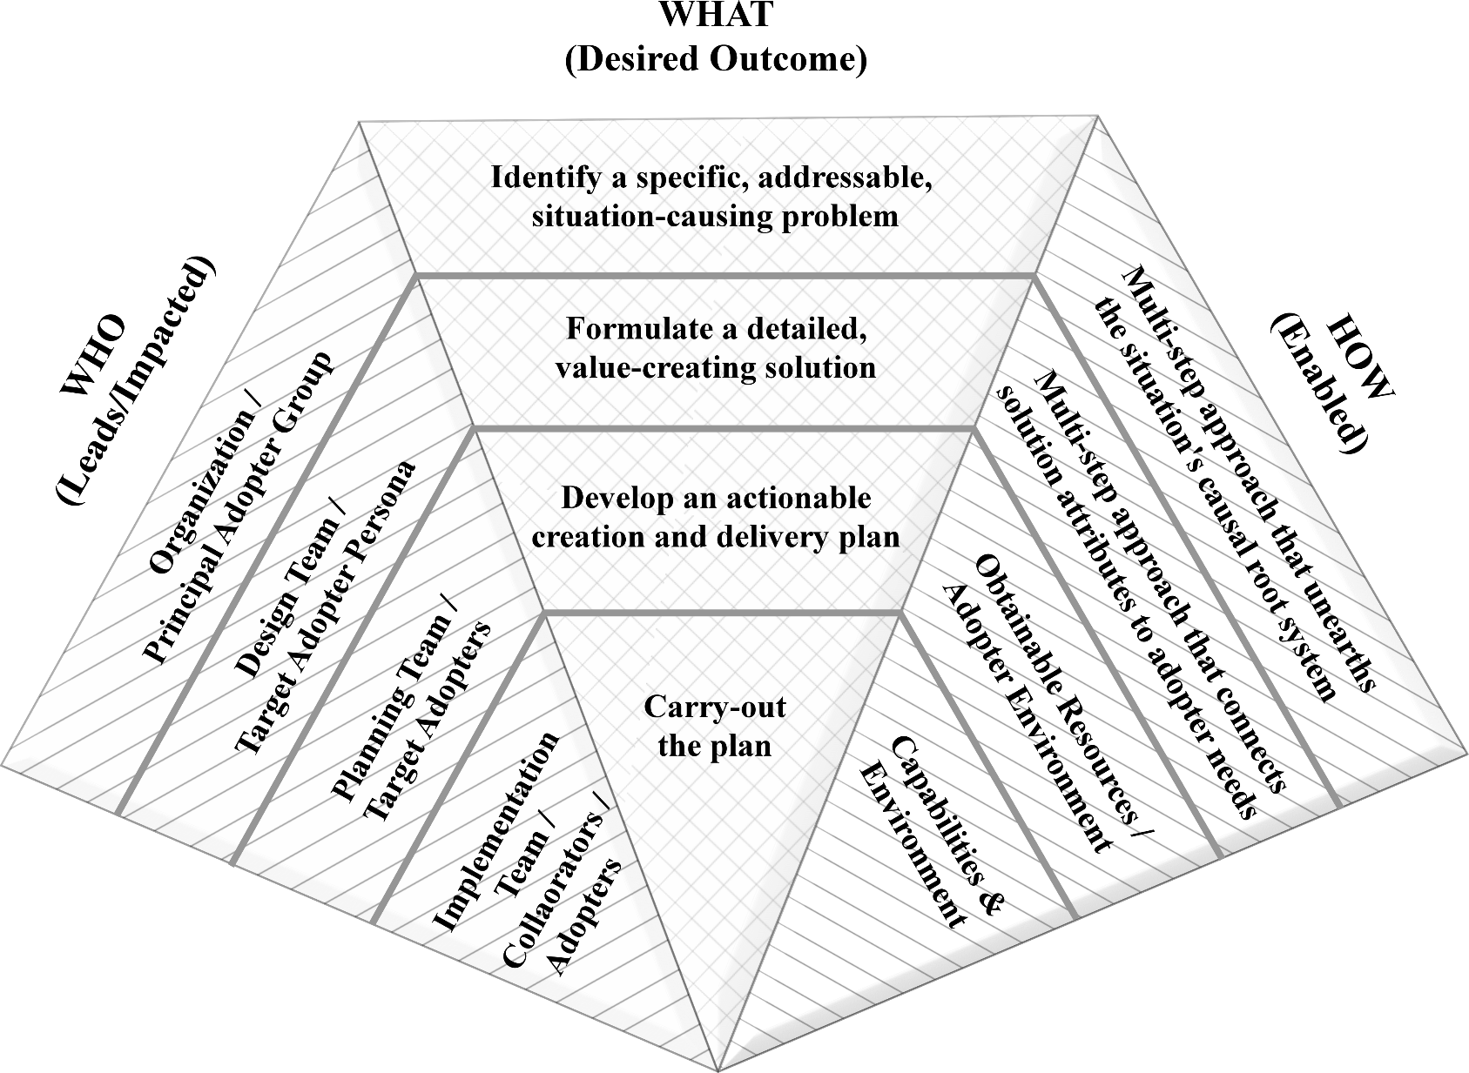
Pyramid Flow
Level 1: Design Stage 1
Level 2: Design Stage 2
Level 3: Execution Stage 1
Level 4: Execution Stage 2

Slide 3
2 Stages to Execution
Execution has 2 separate and distinct stages
  Plan
  Implementation (Perform)
Important to separate the two
We will discuss them together in this course ONLY because the focus on this course is on DESIGN and not Execution.
  Make no mistake, separating these two components of execution is important

Slide 4
Pyramid Level 3, Execution Stage 1
Plan Development
(Chapter 5)

Slide 5
Level 3: Execution, Stage I (Plan)

Slide 6
Outcome of Execution, Stage 1
Actionable plan
  For both creating the innovation and delivering it to the adopter
  What will be done inside organization?
    Internal implementation team identified
  What activities will take place outside organization?
    Identification and alignment of all external collaborators
All resources necessary to implement plan are identified and acquirable, but not yet acquired.
All collaborators identified and on-board.
  “MOU-level” not “contract-level” agreements

Slide 7
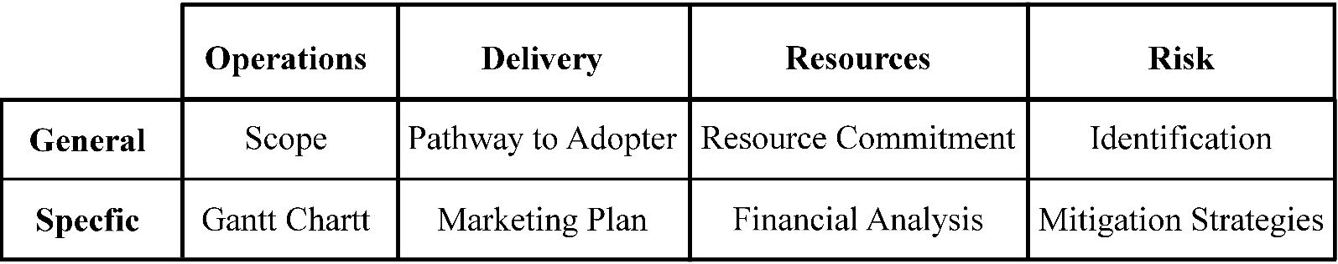
Execution is mainly innovator’s POV
… BUT
  Must make sure there is a pathway for the adopter to obtain the innovation
  Plan must therefore consider both the Innovation Creator’s and Adopter’s environments
Must have resources to execute the plan or must adjust the plan
  REVENUE model also needs to part of “Resources” element if the innovation is going to be “commercial”

Slide 8
The Plan’s other purpose
Primarily the plan is a set of instructions on how the implementation team will create and deliver the innovation. But…
Plan is also a COMMUNICATION and SALES platform
  Used to align support from your supporters
  Turn or neutralize your distractors
Various levels of the “sell” portion of the plan
  Core concept opener
  Elevator pitch
  Support pitch

Slide 9

Core Concept Opener
Core concept opener.
  One or two sentences (should be able to say in one breath!)
  Describes the essence of your innovation project
    The situation
    Desire impact
    Approach for resolving the situation
  Example. We are working on a program to teach students that are on the verge of flunking out of the university new learning strategies.

Slide 10
Elevator Pitch
Elevator pitch.
  One to three minute monolog that provides a brief describes the essence of your innovation project.
    The situation
      Its importance (size or scope)
    The root cause of this situation
    Solution concept
    Resources required (inclusion depends on audience)
    Desired Impact
  Ends with “happy to tell you more” offer.

Slide 11
Elevator Pitch Example
The Territory needs more college-educated citizens to support a growing knowledge-based economy. Without that, we will be unable to move beyond the low-waged, tourist-based economy we currently have.
Today less that 25% of the students that enter UVI will graduate within 6 years. That is an unacceptable number. These bright students are dropping out because of plummeting grades. Why? We discovered that many of these first-generation college students simply have not developed the higher learning skills they need to successfully navigate the fast-paced, information-heavy college courses. They are trying, and failing, to manage these course using only memorization. We need to show them how to implement higher learning strategies.
We are developing a 5-week program to teach at-risk students to utilize these higher-level learning strategies in their courses.
However, our at-risk students generally do not have the financial means of re-taking a course in which they previously performed poorly. Without an ability to retake a course, their grade-point average will keep them at-risk of dropping out of the university. We would like to provide students that have complete our program a single-course scholarship, so they can re-peat a past-failed course, now armed with new learning strategies. We are asking your support to donate money to this special scholarship fund.

Slide 12
Support Pitch
Support pitch.
  Fifteen to thirty minute presentation with visual aids
  Details the situation, desired outcome and root cause
  Solution – Adopter Connection
    Details the value to Target Adopter of detailed proposed solution
  Typically ends with a specific ask or support or call to action
    Time
    Money
    Other
      Great if you can make detractors supporters, but we at least want to neutralize them to prevent them from blocking the project

Slide 13
Level 3: Execution, Stage 1 (Plan Development)

Slide 14
Pyramid Level 4, Execution Stage 2
Plan Implementation
(Chapter 6)

Slide 15
Level 4: Execution, Stage 2

Slide 16
Implementation of the Plan
Level 4 of The Innovation Pyramid is about “getting it done”
  Stage 2 of Execution portion of the Pyramid
Too often implementation focuses on the people alone
  Does the team have the aggregate Capabilities? (see next slide)
  Is their a supportive environment (inside the organization) to assist them? To reward them appropriately?
  Is the external environment
    Are there externalities (legal, social, political) that could prevent the development or implementation of the innovation?

Slide 17
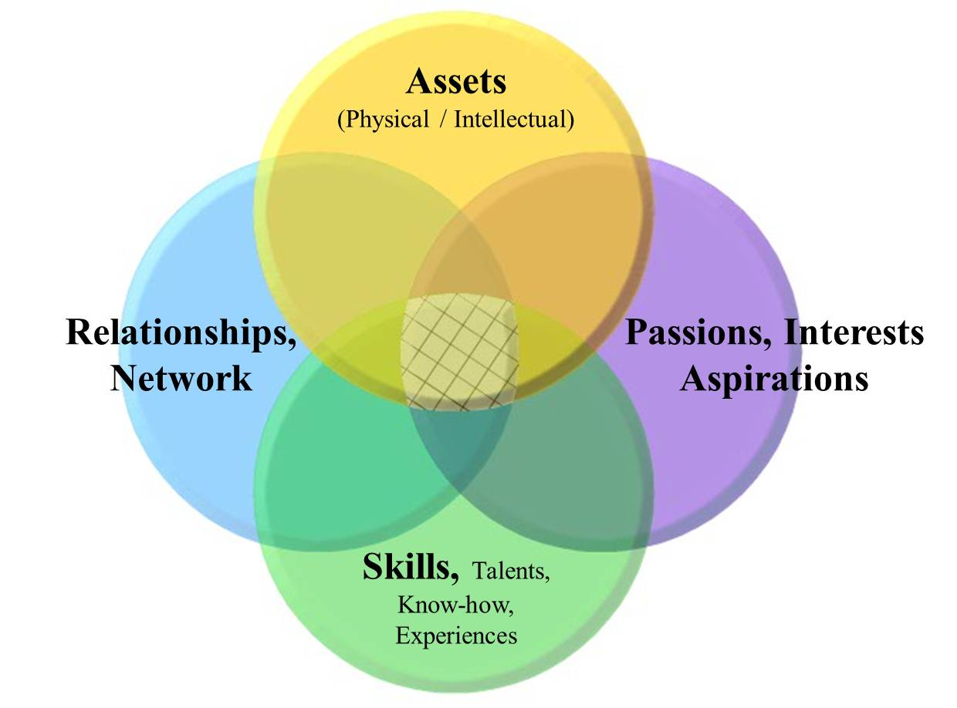
Team Capability Map
Team Capability Map

Slide 18
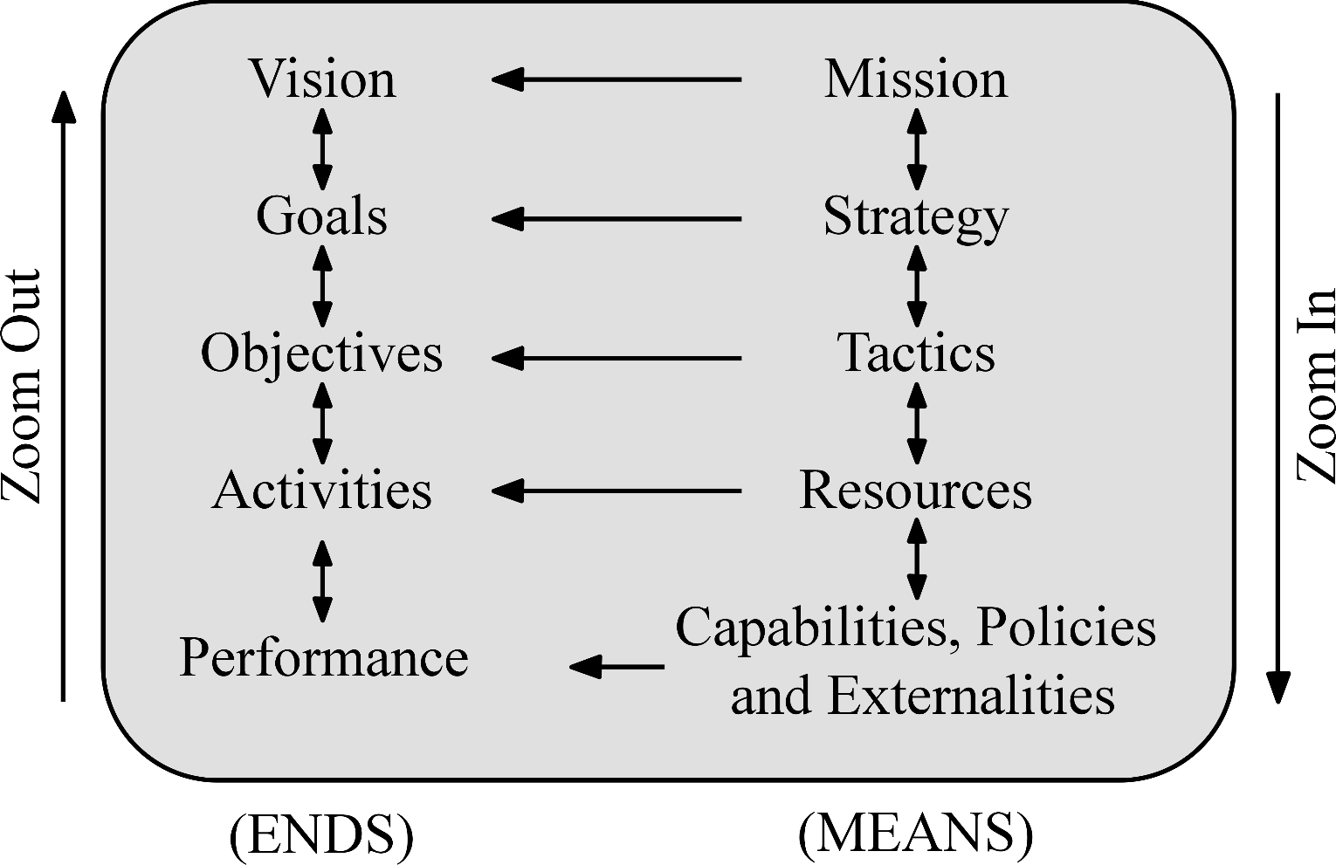
Alignment is crucial
Ref: Modification of Peter Drucker, Management by Objective (1954)

Slide 19
Pyramid Level 4: Execution
Level 4 Is about carrying our the plan
  PERFORMANCE
The organization’s internal environment (work processes, compensation alignment, etc.) must support the innovation
External environment can impact both the innovator and the adopter, making it challenging for both

Slide 20
Outcome of Execution, Stage 2
Innovation has been created
Innovation has been delivered to adopter
Variance Report Created
  Financial (costs and revenues)
  Operations
    Tasks and timing
    Internal team performance
      Internal environment
    Collaborator performance versus plan
    Externalities
  Adopter adoption versus plan
    Quality (validation of value proposition) and Quantity (number of adopters versus plan)
    Adopter environment

Slide 21
Level 4: Execution, Stage 2

Slide 22
Common mistakes
Innovator POV only, forget about the Adopter’s POV
Plan does not identify the necessary recourses
  “Ready to go, just need the resources” is NOT a plan. It is half a plan …. and a hope.
Ignores the externalities
  Items (legal, social, political, etc.) that could inhibit or halt the development or implementation or its delivery to the adopter

Slide 23
Summary
Separating the “Plan” from its “implementation” allows us to focus on primary issues of each.
That separation also aids in the entire Pyramid assessment (next session) that should take place after the innovation project is completed
The plan need acquirable resources (“pledged,” but not necessarily committed)
Plan is also a selling device to obtain resources
Implementation requires people, of course, but also alignment conducive internal and external environments

Slide 24

Questions?
See syllabus for time/date of next Zoom session.

